Slide 1
Drive Your Server Like You Stole It
HOTSOS 2017
Andy Weiss & Kirby Sand

Slide 2
What we do
Engineering Analytics: Using analytics on large datasets to understand what is happening and why, which allows us to generate a feedback loop to R&D, the Call Center, and the Customer.
We collect sensor information like temperature, pressure, speed, tension, etc. as well as device specific information like alarms and faults and states.
The data is linked only by the device it came from and the timestamp.
Using SQL, we combine all the information together in unique ways to develop fundamental models for how things work and why things aren’t working as intended.

Slide 3
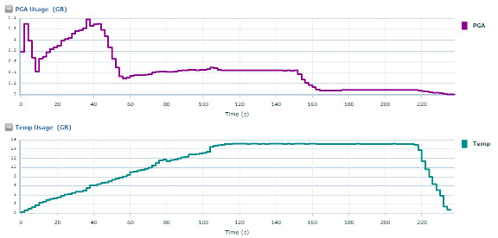
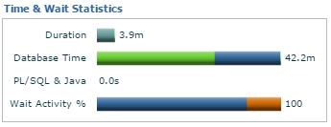
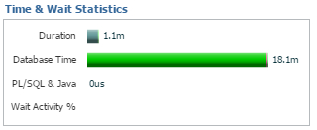
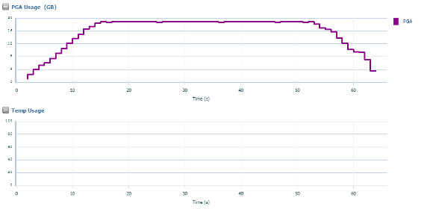
Why are we going to temp?
1.4GB PGA
11.2.0.4
PGA 800GB
72 cores
16GB Temp
Same query with a manual sort area size
19GB PGA
0 Temp

Slide 4
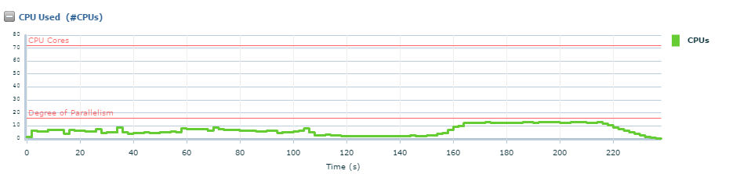
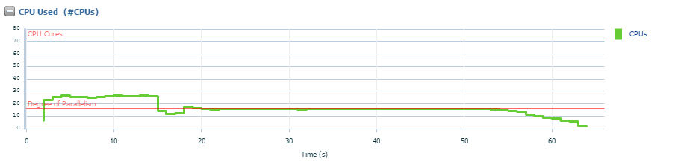
Which also causes inefficient use of CPU

Slide 5
Lets set up a test … how hard can it be?
12.1
512G ram
16 cores
What we thought we new
What we wanted to know
What we actually knew

Slide 6
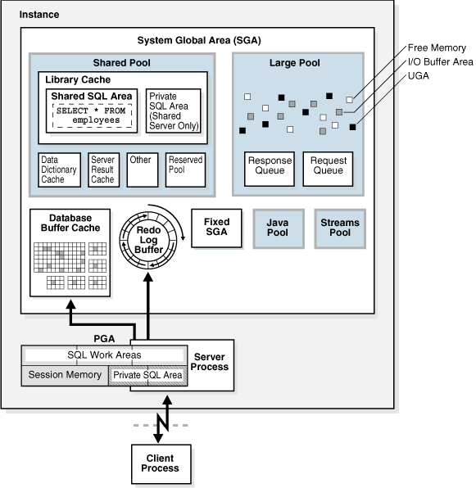
SGA Overview
Quick refresher on SGA memory structures
Areas of interest for us
Buffer Cache
In-Memory Column Store

Slide 7
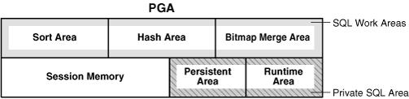
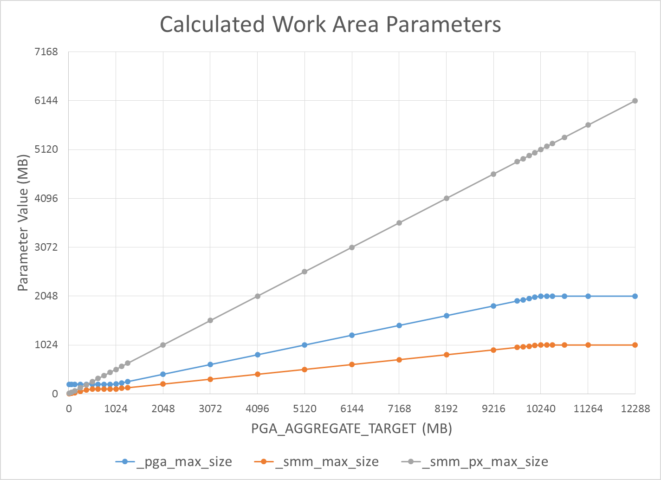
PGA Overview
SQL Work Area
Parallel Execution
_PGA_MAX_SIZE:
PAT < 1GB: 200MB
1GB >= PAT <= 2GB: 20% of PAT
PAT > 2GB: min(2GB, 20% of PAT)
_SMM_MAX_SIZE:
PAT < 512MB: 20% of PAT
512MB >= PAT <= 1GB: 100MB
PAT > 1GB: min(1GB, 50% of _PGA_MAX_SIZE)
_SMM_PX_MAX_SIZE:
Always 50% of PAT
Work Area = min(_SMM_MAX_SIZE, _SMM_PX_MAX_SIZE / DoP)

Slide 8
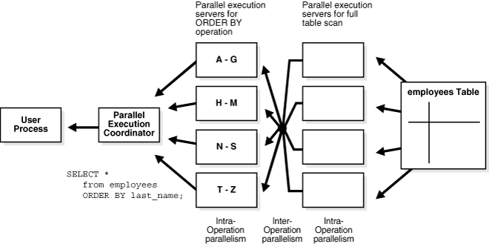
Parallel query
Areas of interest for us
Queuing
PX server pool
Granules

Slide 9
Experiment Overview
All Experiments Used The Same Standard Tables and Queries
4 common types of queries
Parent/Child join with analytic functions (avg/median/stdev/etc)
100:1 rows joined on a key
Large Table (100GB, 5B rows)
Parent/Child table join and filtering
100GB of data
Single table with analytic functions (avg/median/stdev/etc)
Small table (7GB, 32M rows)
Windowing Functions (lead/lag)
Medium Table (60GB, 2.5B rows)
All queries run multiple times back-to-back 3 times to see effects of caching
All tables uncompressed and not partitioned

Slide 10
Experiment # 1: Tuning PGA
pga_aggregate_target = 192GB
_pga_max_size = 2GB
_smm_max_size = 1GB
_smm_px_max_size = 96GB
With this setup, we can never have a work area larger than 1GB.
What happens if we manually set _pga_max_size?

Slide 11
Experiment # 1: Tuning PGA
We manually set _pga_max_size
ALTER SYSTEM SET “PGA_MAX_SIZE” = 2G
ALTER SYSTEM SET “PGA_MAX_SIZE” = 4G
ALTER SYSTEM SET “PGA_MAX_SIZE” = 6G
We forced DOP with a hint
/*+ PARALLEL(16) */
/*+ PARALLEL(32) */
/*+ PARALLEL(64) */
We forced buffer cache to be small
512MB (no table fits)
We tracked resource usage
Workarea Size (PGA and Temp)
Time (Run Time, CPU Time, IO Wait, DB Time)

Slide 12
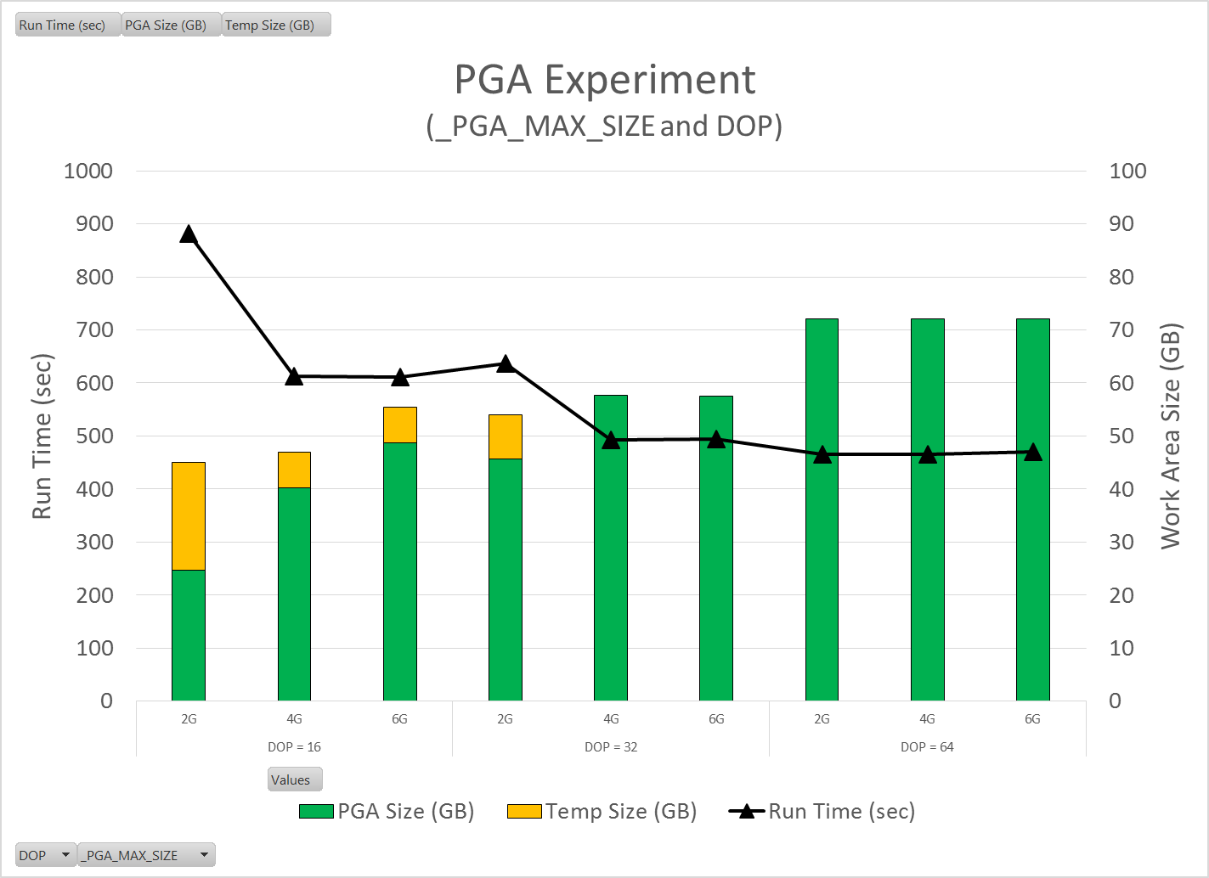
Experiment # 1: Tuning PGA
Biggest gains happen when we never go to temp.
Approx. 1.8X improvement
If we accept the default PGA_MAX_SIZE we have to use a very high DOP to get away from swapping to temp.
We never come close to approaching our PGA_AGGREGATE_TARGET (192G).
So what is the best PGA_AGGREGATE_SIZE?
It depends on your typical workload.

Slide 13
Experiment # 2: Tuning PGA
We manually set parallel degree policy
ALTER SYSTEM SET PARALLEL_DEGREE_POLICY = MANUAL
ALTER SYSTEM SET PARALLEL_DEGREE_POLICY = AUTO
ALTER SYSTEM SET PARALLEL_DEGREE_POLICY = ADAPTIVE
We manually set Big Table cache percent target
ALTER SYSTEM SET DB_BIG_TABLE_CACHE_PERCENT_TARGET = 10
ALTER SYSTEM SET DB_BIG_TABLE_CACHE_PERCENT_TARGET = 50
ALTER SYSTEM SET DB_BIG_TABLE_CACHE_PERCENT_TARGET = 90
We forced DOP with a hint
/*+ PARALLEL(32) */
We forced PGA_MAX_SIZE
ALTER SYSTEM SET “PGA_MAX_SIZE” = 4G
We made buffer cache big
192GB
We tracked resource usage
Workarea Size (PGA and Temp)
Time (Run Time, CPU Time, IO Wait, DB Time)
V$BT_SCAN_OBJ_TEMPS

Slide 14
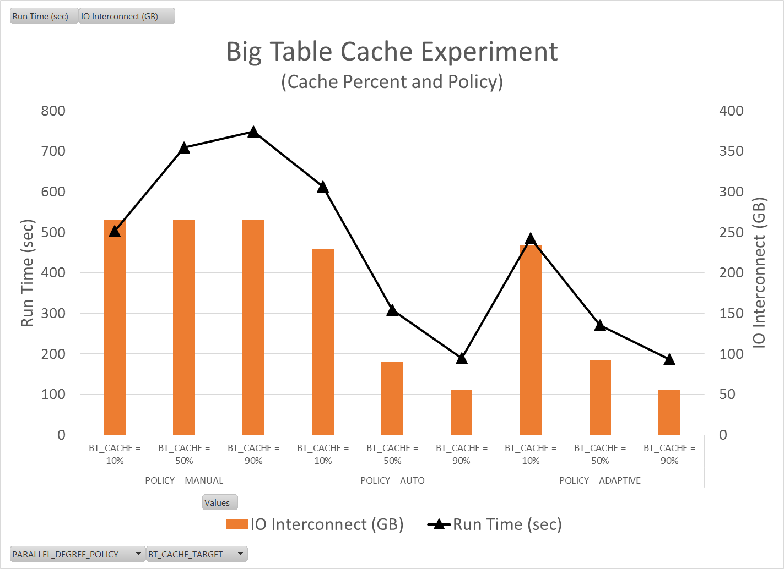
Experiment # 2: Big Table Caching
Policy = Manual
Notice that as the cache percent target gets large, the queries slow significantly. Big tables do appear to go into the standard buffer cache
Policy = Auto/Adaptive
As you increase the big table cache percent you get significant query speed improvements.
4.7X speed improvement from worst case
2.6X speed improvement from the default
However, you still have to go disk for some of the data.

Slide 15
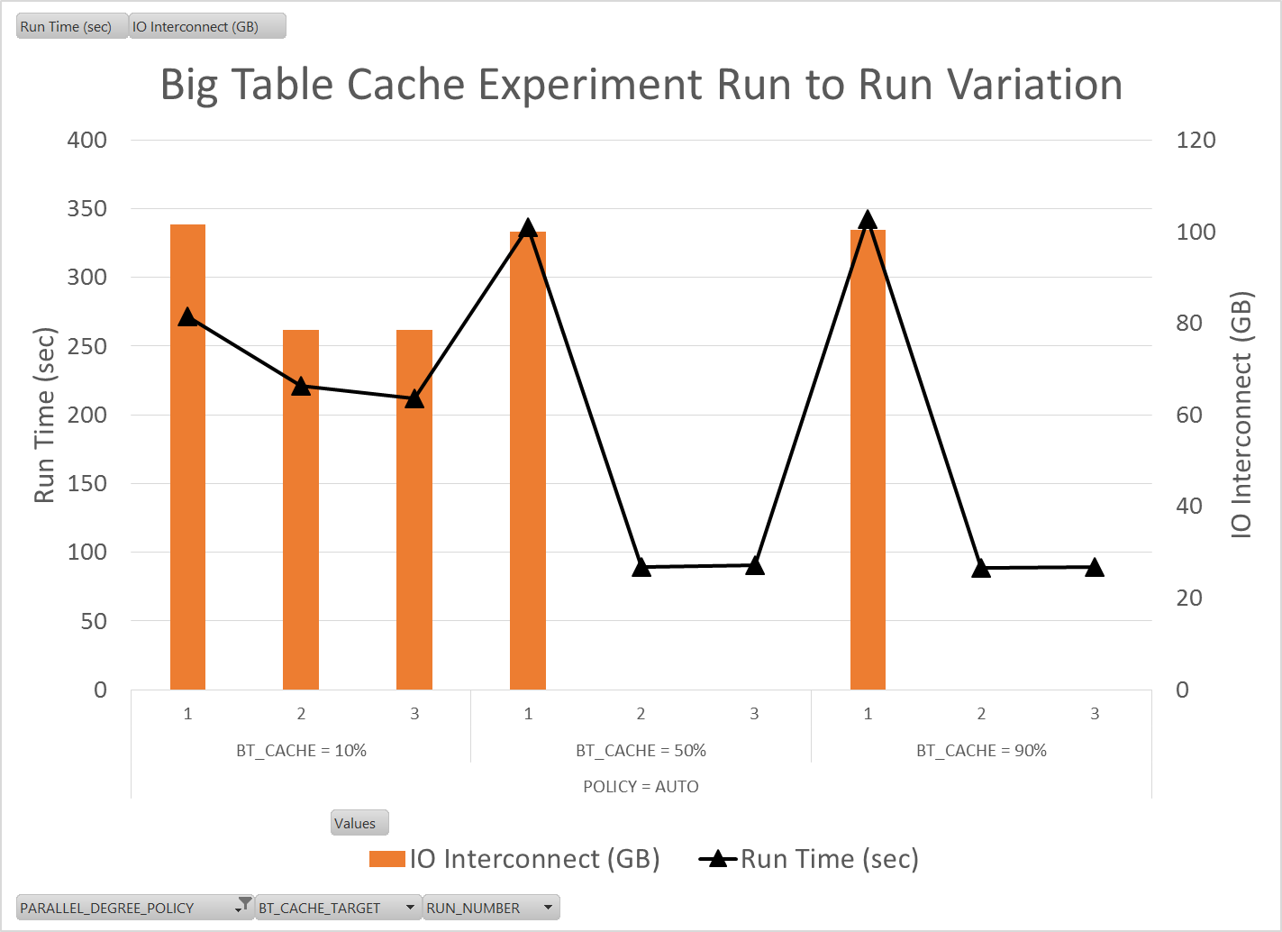
Experiment # 2: Big Table Caching
Notice that you appear to pay a penalty on the first run, but if your buffer cache is large enough you really reap the benefits of the subsequent runs.

Slide 16
Experiment # 3: In-Memory Column Store

Slide 17
Experiment # 4: Statement Queuing

Slide 18
More Results to Follow

